Slide 1


Telecom Churn Prediction Capstone Project 2
Welcome to our capstone project presentation. Over the next slides, we will take you through the key elements of our comprehensive study, from the initial objectives to the impactful findings and recommendations for the future.
BY :- ADITYA KUMAR GUPTA

Slide 2
Project Objectives
Data Understanding & Preparation.
2. Data Visualization & Handling Class Imbalance.
3. Conventional Machine Learning Model & Hyperparameter Tuning.
Neural Network Model & Hyperparameter Tuning.
Misclassification Cost , Business Insights & Recommendation.

Slide 3
Introduction
Customers in the telecom sector have the ability to actively move between different operators and select from a variety of service providers. The annual churn rate in the telecommunications sector is between 15 and 25 percent on average in this fiercely competitive market. Customer retention has surpassed customer acquisition in importance since it is now five to ten times more expensive to keep an existing customer than to acquire a new one. The primary objective for numerous established operators is to hold onto their highly lucrative clientele. Telecom firms need to identify which customers are most likely to leave in order to minimize customer attrition. In this project, you will analyze customer-level data from a top telecom company and create prediction models to find those who are most likely to leave.

Slide 4
Tasks Involved
Task 4: Visualize the data
Analyze the data to extract relevant insights through informative visualizations
Look for any outliers and treat them
Task 1: Import libraries and load the dataset.
Task 2: Understand and explore the data. Analyze different feature types in the data
Handle missing values by imputation
Task 3: Conduct feature engineering
Extract new relevant features from the data set
Filter high-value customers
Derive the target variable “churn” based on the existing features
Task 6: Business insights and recommendations
Understand the profitability of the telecommunication service program, and estimate the impact of your model using misclassification costs. Propose a solution to leverage customer interaction/feedback data and predict those who are highly likely to churn.
Task 5: Modeling
Divide the data into train-test splits Build different machine learning models and evaluate their performance. Tune the hyperparameters to optimize the performance for the best model. Train and evaluate a neural network model with the optimal combination of hyperparameters

Slide 5
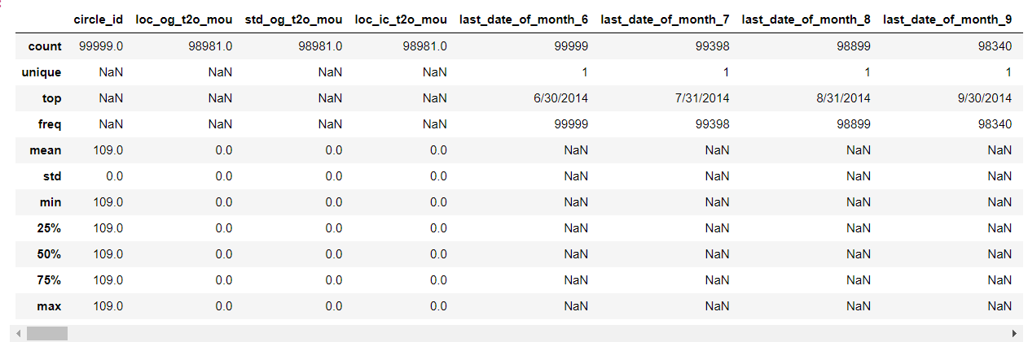
The dataset, which includes 225 features and almost 100,000 observations, captures a range of user behaviour metrics, including service plans, call and internet usage, recharge amounts, and usage patterns. We started by analyzing and investigating the data, filling in the blanks, and performing feature engineering. Key elements impacting turnover, such as contract type, duration, and monthly charges, are found through exploratory data analysis.

Slide 6
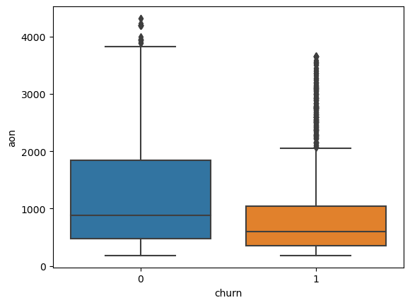
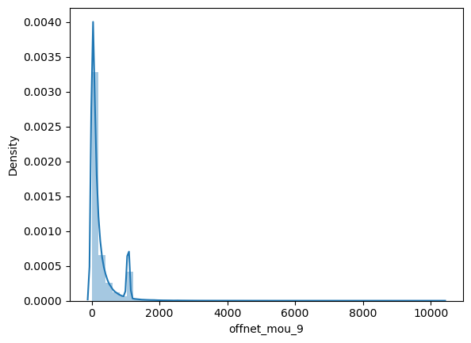
In the preprocessing phase of the data analysis, we addressed missing values by evaluating their ratio and dropping variables with excessive missing data. We utilized the Multiple Imputation by Chained Equations (MICE) method to handle remaining missing values effectively. Categorical variables were encoded to facilitate modeling, followed by feature engineering to enhance predictive power. We also derived the churn variable to indicate customer retention or attrition. For data visualization, we performed univariate and bivariate exploratory data analysis (EDA) to uncover relationships among features, focusing on metrics such as Average Revenue per User, local and STD minute usage, and call patterns both within and outside the operator's network.
Implemented the outlier capping function to cap the outliers present in all the numeric columns as shown in the above boxplot.

Slide 7
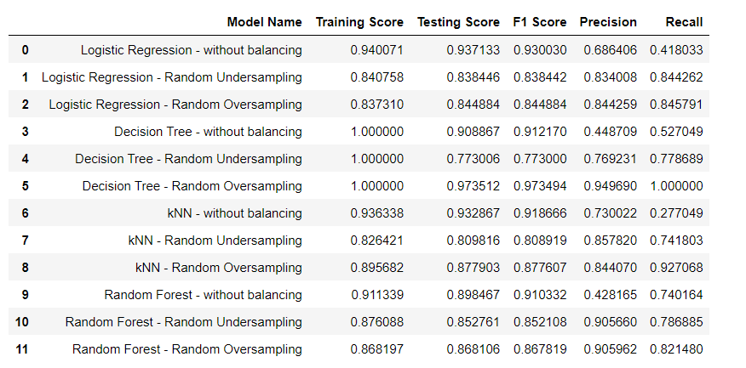
Using criteria like accuracy, precision, recall, F1-score, and ROC-AUC, a number of machine learning methods, including logistic regression, decision trees, KNN, and random forests, were assessed. The Decision Tree model proved to be the best, especially when paired with Random Oversampling to alleviate the imbalance in classes. GridSearchCV was used to optimise the hyperparameters, bringing them down to max_depth = 30 and random_state = 0. With a testing accuracy of 97.35% and a training accuracy of 99.81%, the model demonstrated remarkable performance. With recall at 1.0 and precision at 0.9496, the test's F1 score was 0.9734. The perfect recall shows that these indicators show strong performance, especially when it comes to managing class imbalance.
Model Evaluation

Slide 8
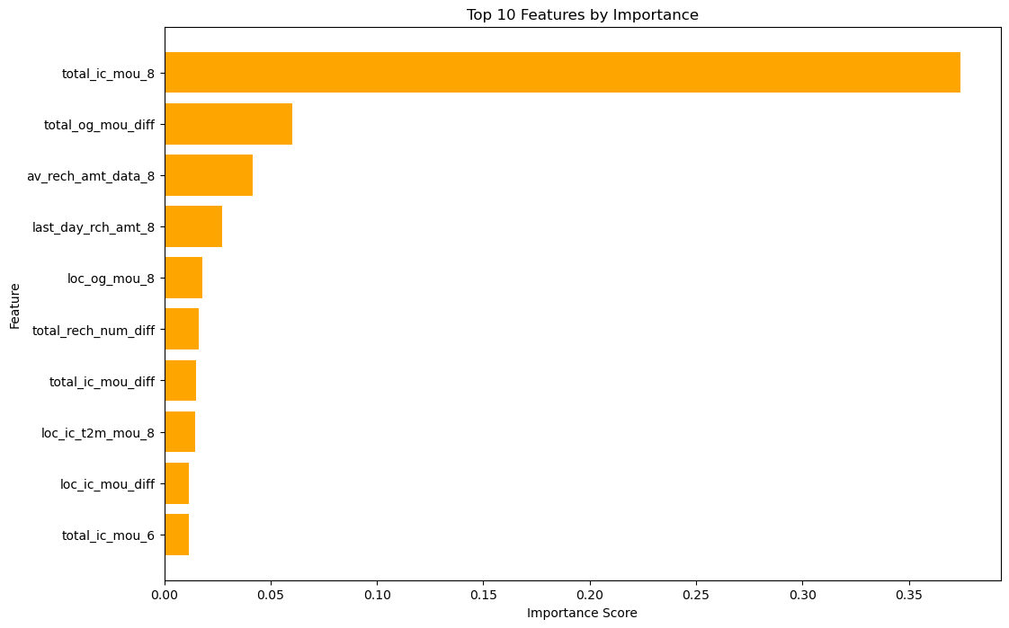
Feature Importance
The graph shows the top 10 features by importance in a machine learning model, with `total_ic_mou_8` being the most significant predictor. Other notable features include `total_og_mou_diff`, `av_rech_amt_data_8`, and `last_day_rch_amt_8`. While features like `loc_og_mou_8`, `total_rech_num_diff`, and `total_ic_mou_diff` have moderate importance, `loc_ic_t2m_mou_8`, `loc_ic_mou_diff`, and `total_ic_mou_6` are the least important among the top 10. Overall, `total_ic_mou_8` plays a crucial role in the model's predictions, with the other features also contributing to varying degrees.

Slide 9
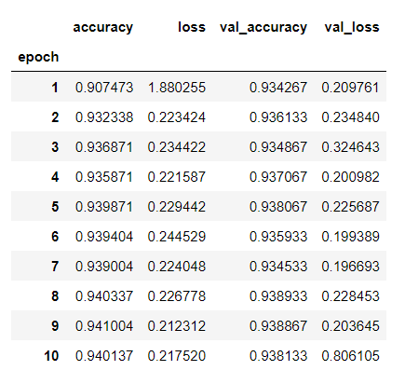
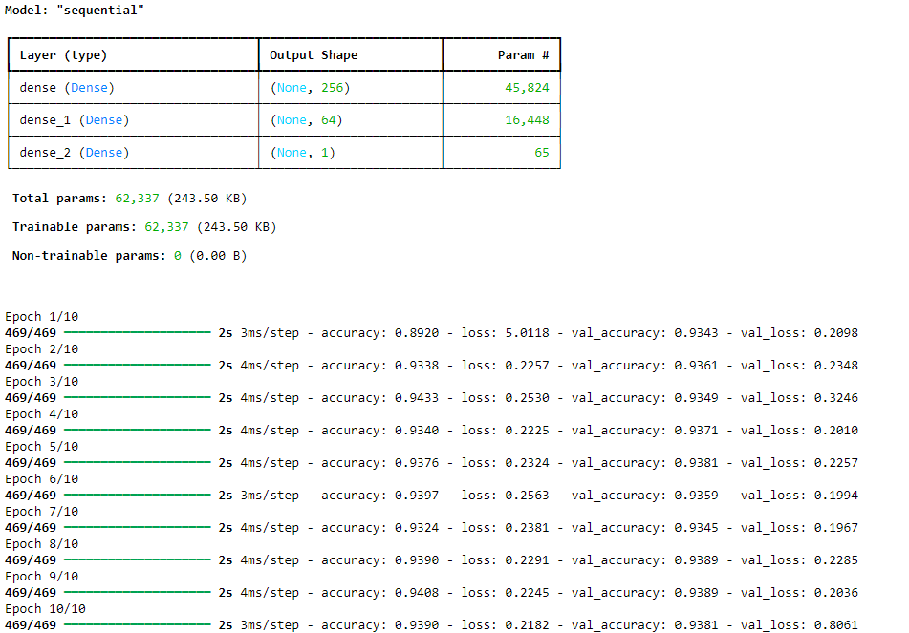
Complex patterns in the data are captured using a neural network model. TensorFlow's Keras package was used to construct the model. Input Layer: The amount of features in the dataset was taken into account when defining the input layer. Hidden Layers: A configurable hyperparameter determined how many neurons were in the initial hidden layer. There were 64 neurons in the second hidden layer, which was fixed. 'Sigmoid' activation functioned solitary neurons in the output layer, which carried out binary categorization.
Neural Networks

Slide 10
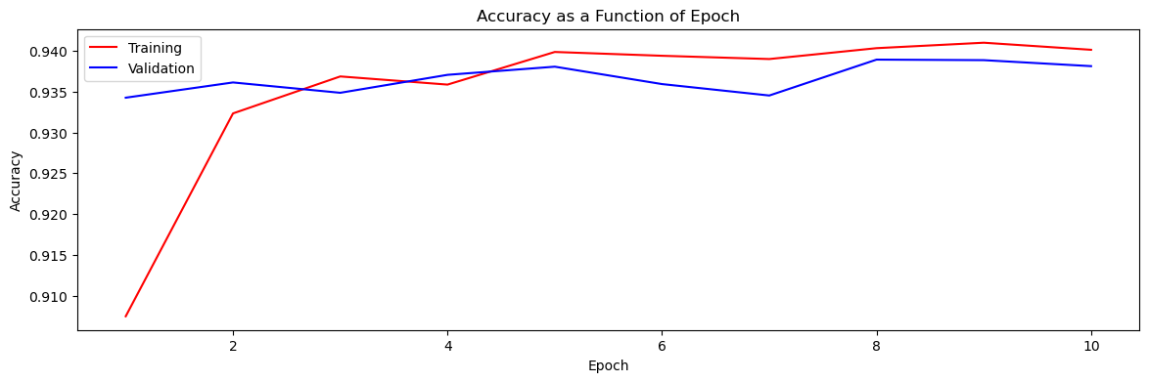
Impactful Findings
The performance of the model throughout training and validation over ten epochs is displayed in the accuracy as a function of epoch graph and the table that goes with it. Training accuracy steadily increases; by the tenth epoch, it is approximately 0.940. Validation accuracy is near but varies significantly, reaching a maximum of approximately 0.938. Validation loss fluctuates slightly but stays generally low, while training loss slowly declines to show learning. The tight alignment of training and validation accuracies indicates that the model performs well overall with little overfitting.

Slide 11
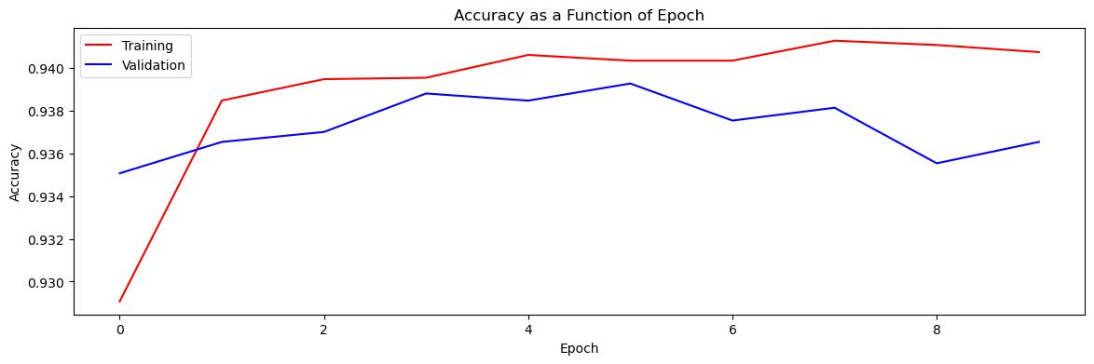
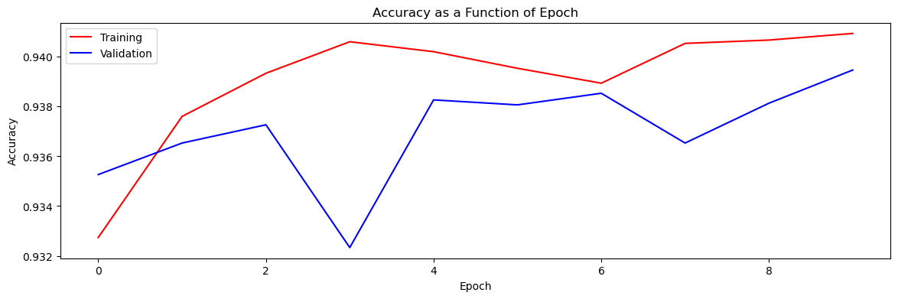
GridSearchCV and RandomizedSearchCV were used for hyperparameter tuning, which optimized the activation function and the number of neurons in the neural network's first hidden layer. The {sigmoid} activation function was shown to be optimal by both techniques. While 448 neurons attained an accuracy of 0.9330, GridSearchCV discovered that 512 neurons produced the best accuracy of 0.9396. While validation accuracy showed more volatility, training accuracy increased consistently and stabilized in the accuracy plots for both approaches, with GridSearchCV obtaining slightly superior accuracy and stability.
Hyperparameter Tuning
GridSearchCV
Randomized SearchCV

Slide 12
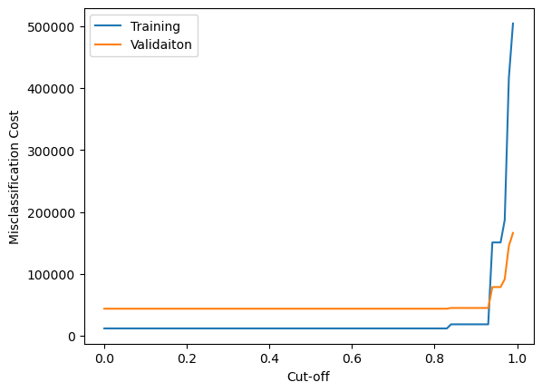
Misclassification Cost
With a maximum depth of 30, the trained decision tree classifier produced training accuracy of 99.8% and validation accuracy of 97.4%. The model has an F1 score of 0.9735, recall of 1.0, and precision of 0.9497. For false negatives, the misclassification costs are $500, and for erroneous positives, they are $300. With 146 false positives and zero false negatives, the validation set's current misclassification cost is $43,800. The training data's optimal cut-off value was determined to be 0.000, which resulted in a training cost of $12,000. However, this cut-off causes the validation set to have the same $43,800 misclassification cost.

Slide 13
Business Insights and Recommendation
Telecom companies' earnings are greatly impacted by customer attrition, and forecasting churn is essential to putting retention plans into action. The model's strong recall and accuracy rates guarantee efficient churn prediction, reducing revenue loss by accurately identifying almost all churners. With 146 false positives and 0 false negatives, the model's performance resulted in $43,800 in misclassification costs. This suggests that more cut-off tuning could lower costs. By creating tailored interventions, automating assistance, and identifying churn signs in customer interactions, leveraging NLP, LLMs, and generative AI can increase profitability. Scalable solutions, collaborations, and agile development are necessary to overcome data privacy, resource limitations, and integration issues in order to implement these cutting-edge methodologies.

Slide 14

Conclusion
In conclusion, implementing state-of-the-art machine learning and artificial intelligence approaches can significantly enhance the telecommunication service program's ability to predict and minimize customer attrition. The company may increase profitability and provide a more satisfying and customized customer experience by implementing LLMs and Generative AI, reducing misclassification costs, and leveraging NLP for deeper insights.
The goal of this kind of study in the telecom industry is to increase profits for businesses. It is now well known that one of the key revenue streams for telecom firms is churn prediction. Thus, the goal of this research was to develop a system that forecasts client attrition in a telecom company. AUC values for these prediction models must be high.

